Slide 1
STAKEHOLDER REVIEW · v0.2
Aara
Teams Aggregator Bot
Sign-off review of the v0.2 PRD and architecture pack ahead of Phase-0 alpha.
Today we'll cover: what we're building, how it works, key choices, the 12 decisions we need from this room, and the timeline to alpha.
Project leadership
Eng lead
IT / Security
AT&T AI team
approve scope · sign off PRD
validate architecture · own build
approve network + RSC + DPIA
confirm AskAT&T integration plan
Raja · Product · May 2026

Slide 2
The problem
Project coordination already happens in Teams. The chats are the system of record — but the chats are not legible.
1–2 hrs
5 chats
0
per project lead, every cycle, scrolling threads to compile status
where coordination lives: engineering, design, leadership, vendor, group DM
system of record for decisions and commitments
Today, on a typical cycle:
Action items get committed mid-thread and rarely make it into Planner / Jira.
Decisions are undocumented — "we agreed in Teams" is unfindable a week later.
Updates are inconsistent — each lead writes a different shape, execs can't compare week-over-week.
Cross-channel context is invisible — engineering doesn't see the leadership chat; leadership doesn't see the vendor thread.

Slide 3
What we're building
Aara: a Microsoft Teams bot that captures across designated Aara chats and @mentions, then ships a single, citation-backed digest.
How it captures
What it outputs
Two well-scoped modes — only these two.
Same shape every time — on-demand or scheduled.
Mode A · Designated channels Admin registers Aara channels or group chats via /Aara channels add. All new messages are eligible inputs (subject to topic filter).
TL;DR — 3–5 sentence executive summary of the window.
Action items — description · owner · due · status · source-message link.
Decisions — what was decided, by whom, with context and source link.
Path forward — prioritized next steps (max 7).
Follow-up notes — open threads and who should chase them.
Risks · blockers · open questions.
Mode B · Explicit @mention In any chat, anyone can @Aara include this on a message. Includes that message and its thread parent. Useful for cross-functional chats.
Out of scope: keyword-only mode, LLM sweep of the whole tenant, 1:1 DMs.
Every item carries a source-message citation. Items without one are rejected at extraction and routed to triage.

Slide 4
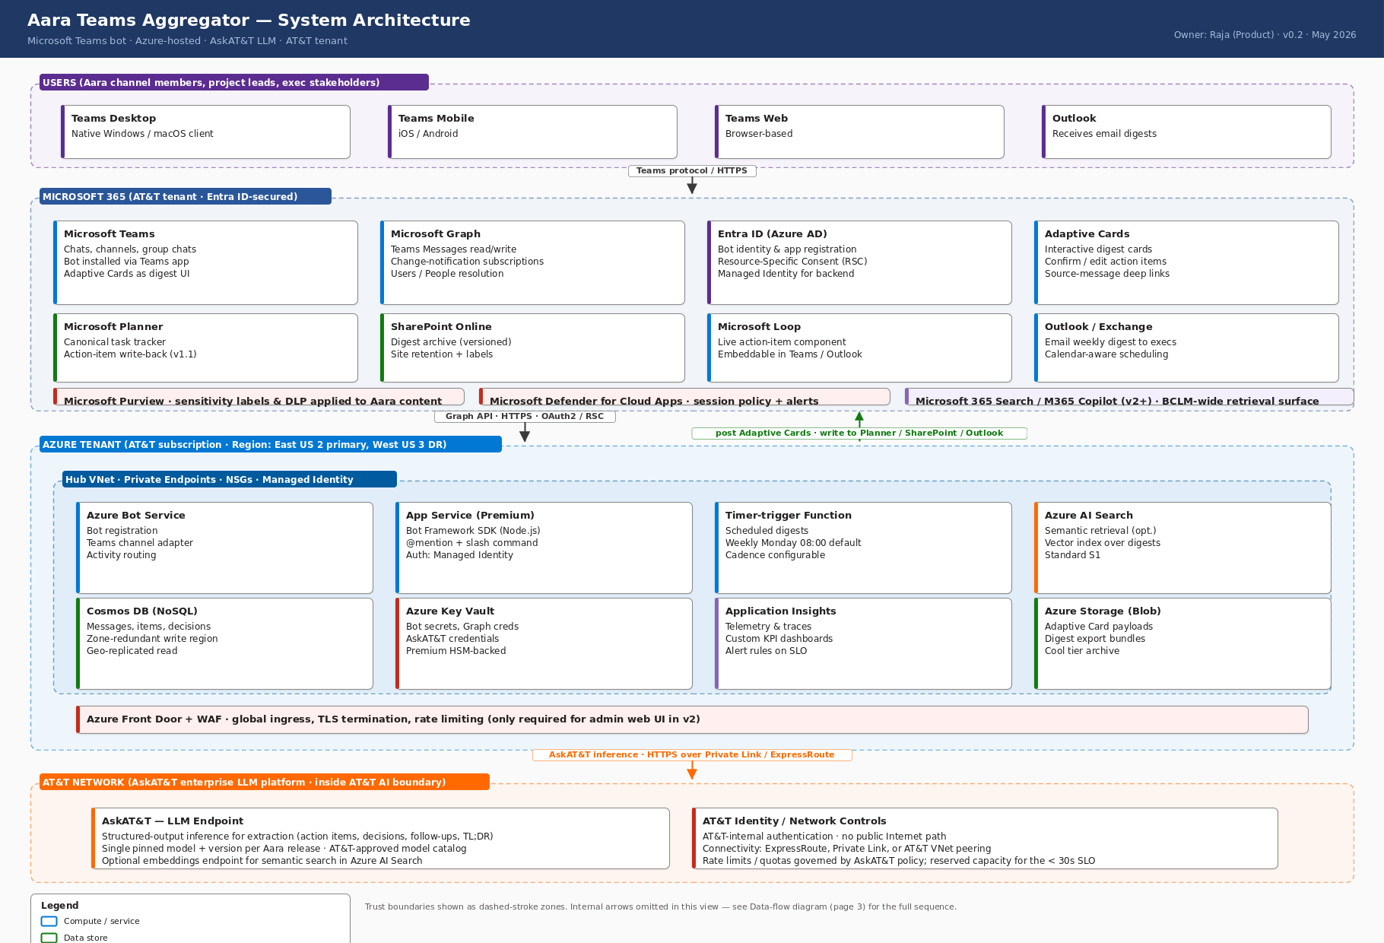
Architecture at a glance
Four trust zones top-to-bottom. The LLM hop goes via private network to AskAT&T — no public-Internet AI providers.
Full architecture pack (4 views: system · network/security · data flow · deployment) in 02-architecture/.

Slide 5
Key design choices
Four opinionated choices that shape the rest. Any of these can change scope, cost, or risk meaningfully.
AskAT&T as the only LLM
Microsoft 365-native
Non-negotiable for v1.
Don't recreate what M365 already does.
All extraction and summarization calls go to AskAT&T. No public OpenAI / Anthropic / Google / Azure OpenAI. Narrows the DPIA scope and keeps message content inside AT&T's AI boundary.
Teams · Graph · Adaptive Cards · Entra ID + RSC for v1. Planner write-back, SharePoint archive, Loop components, Outlook digest in v1.1. M365 Copilot agent surface in v2.
Dual-mode capture
Digest-oriented, not paging
Designated channels OR @mention. Nothing else.
Recall over recency.
No keyword-only mode, no whole-tenant LLM sweep, no DMs. Predictable scope, simpler IT review, fewer surprises.
On-demand + weekly scheduled digest. Same shape every time. Not real-time alerts — this is not an incident-response tool.

Slide 6
Phased rollout
Four phases. Each has a clear exit criterion. We can stop at the end of any phase if metrics don't land.
Phase 0
2 weeks
Phase 1
4 weeks
Phase 2
ongoing
Phase 3
future
Alpha
Beta
GA
Integrations
1 admin + 2 leads · 2 channels
On-demand digest only
PM manually reviews every digest
Exit: ≥ 80% action-item recall · < 5% hallucinated owners
All Aara channels · @mention enabled
Weekly scheduled digest
Planner + SharePoint + Loop enabled (v1.1)
Exit: §12 metrics met · IT + Purview sign-off · ≥ 70% read-rate
Multi-project (any team can install)
Self-service for project leads
M365 Search + Power BI
Bidirectional Planner / Jira / ADO
Meeting transcripts as input
Cross-project rollups
M365 Copilot agent

Slide 7
Decisions needed before Phase-0 alpha
12 open questions tracked in Aara_Decisions_Needed.docx — grouped here by stakeholder.
AT&T AI team
IT — Identity / Network / App Catalog
4 decisions · due Jun 5
3 decisions · due Jun 2–5
Q3 · Model + version + deprecation calendar
Q4 · Rate limits + reserved capacity (12 / 30 RPS)
Q5 · JSON-mode support or schema-retry wrapper
Q6 · Embeddings endpoint? (or drop semantic search)
Q2 · Named Teams app reg + RSC owner
Q7 · Network path to AskAT&T (ExpressRoute / Private Link)
Q11 · App catalog approval lead time
Product (Raja)
Compliance / Records
4 decisions · due Jun 2–Jul 7
1 decision · due Jun 2
Q1 · Initial Aara channel list (recommend 2 for alpha)
Q8 · Planner write-back direction (one-way in v1.1)
Q10 · /Aara channels add authorization (admin-only)
Q12 · English-only v1
Q9 · Retention: 90-day raw / indefinite extracted

Slide 8
Asks for this meeting
Concrete commitments we need to leave with.
Project leadership
Approve the v0.2 PRD scope and the Phase-0 alpha exit criteria. Confirm the BCLM project lead is the named Aara admin.
Eng lead
Validate the architecture pack. Commit to authoring the LLM-client-wrapper ADR and the change-notification spec in week 1.
IT — Identity & Network
Name the Teams app registration owner. Confirm the AskAT&T network path and the 2-week lead time. Decide on the DPIA reviewer.
AT&T AI team
Schedule the integration deep-dive in week 1. Bring answers (or option-space) to Q3–Q6 by Jun 5.
Compliance
Confirm the 90-day raw / indefinite extracted retention policy, or propose a tighter alternative we can live with.
Timeline
Jun 2 decisions deadline · Jun 5 AskAT&T + network deep-dive · Jun 9 Phase-0 alpha kickoff · Jul 7 Phase-1 beta start

